Slide 1

Improving Length of Stay Prediction
Using a Hidden Markov Model
S04
Machine Learning in Clinical Predictive Modeling I
Presenter : Mani Sotoodeh
Institution : Department of Computer Science - Emory University
Twitter: @Manis29467226
#IS19

Slide 2

Importance of Length of Stay Prediction
Intervention to prevent adverse outcomes
Optimization of resource allocation and staff
Improving patients' satisfaction and hospitals’ reputation
Class | < 48 Hours | 2-5 days | > 5 days
Accuracy | 53.1 % | 59.8 % | 31.1 %
Adapted with changes from : Nassar Jr AP, Caruso P. ICU physicians are unable to accurately predict length of stay at admission: a prospective study. International Journal for Quality in Health Care. 2015;28(1):99–103.
Notes:
Physician correctly predict short or long staying patients only 50% of time
(Equipment and Beds)
Allocation of staff and care to high risk patients

Slide 3
Motivation, The case for HMM
Regression → more precise
Dynamics of physiological signals
States interpretability
Notes:
Rather than classification
Possibly indicating severity or progress of patients’ underlying disease symptoms
Evolution through time

Slide 4
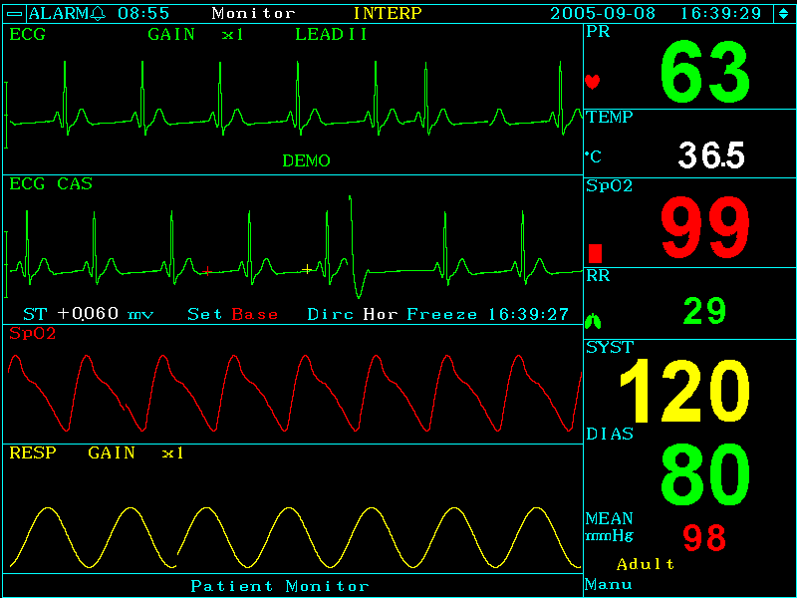
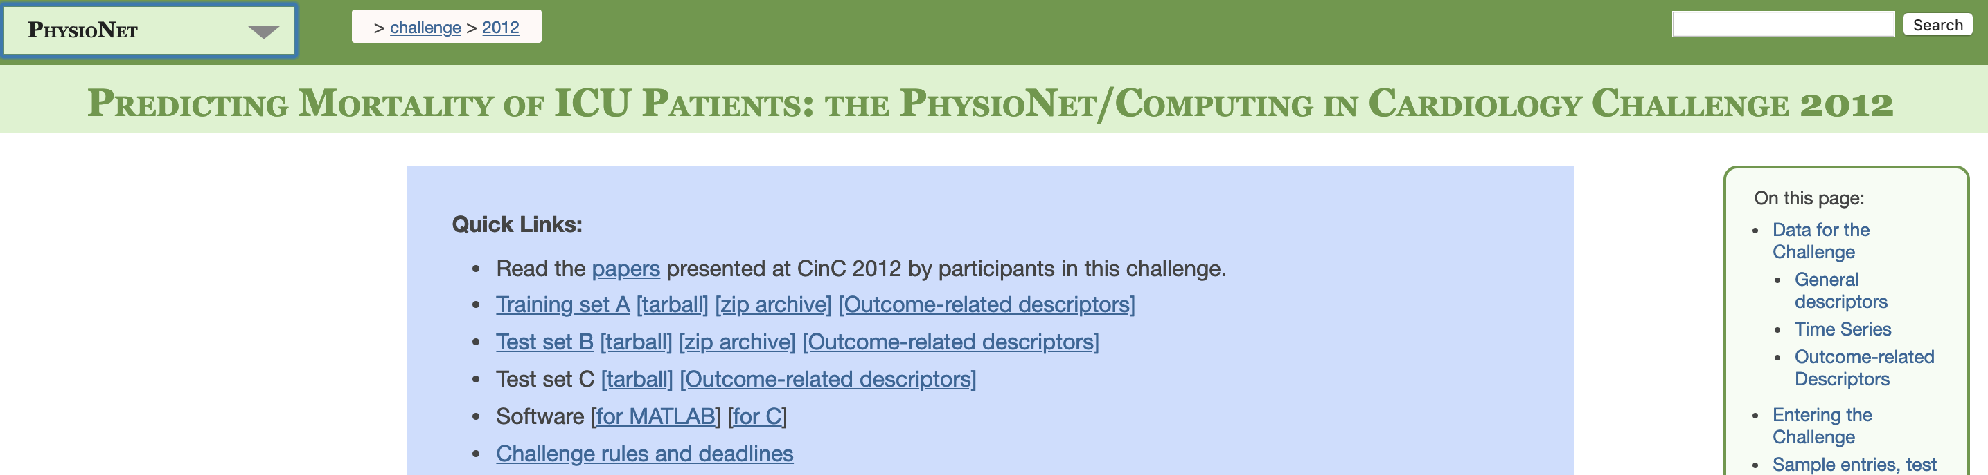
Dataset : Physionet2012 Challenge
Demographics
37 physiological measurements
4000 patients
48 hours after ICU admission
Publicly available, hassle free, reproducible
Higher availability for comparison
Sufficient size for learning, realistic for practical purpose
https://physionet.org/challenge/2012/
Notes:
, i.e. a single hospital
(i.e. age, gender)

Slide 5
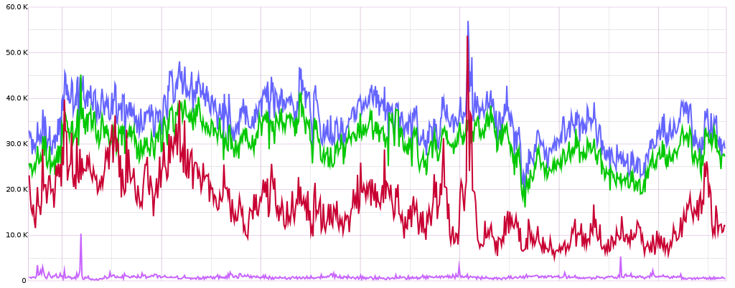
Regression Task, Big Picture
Selected patient’s time series data for first 48 hours
Feature | Avg update frequency (hours) | Avg # of observations | Missing %
Glasgow Coma Scale | 17.33 | 13.26 | 1.6
Temperature | 3.7 | 16.31 | 1.6
Heart Rate | 1.05 | 46.48 | 1.6
White Blood Cell Count | 17.057 | 2.63 | 1.8
Serum Glucose | 4.03 | 2.72 | 2.8
Urine Output | 1.89 | 28.65 | 2.9
NIDiasABP | 1.87 | 21.73 | 12.7
12
24
36
48
Time(hours)
Prediction Model
Patient’s Length of Stay(days)
Notes:
Impute results in bias, where more data is available through data, better signal for patient states, good proxies
Input : Physiological Measurements throughout time for 48 hours
Output : Length of stay in ICU in days

Slide 6
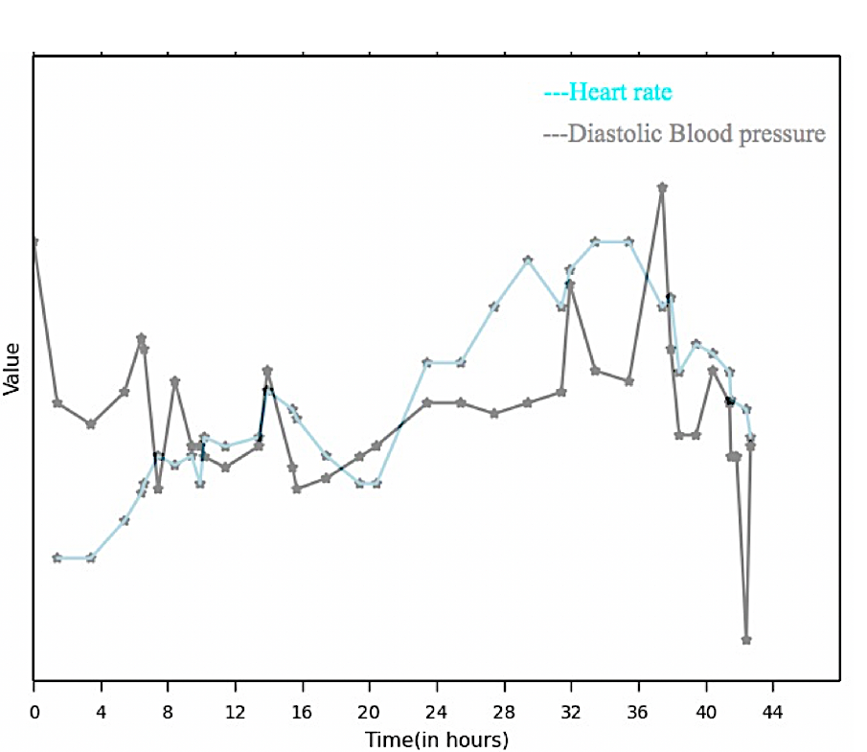
Baseline Models (5 regression models)
Flattened Features :
Minimum
Maximum
Average
First in time
Last in time
Utilization of all temporal information in HMM
Annotated example for a given patient and 2 physiological measurement
BP maximum
BP First
HR maximum
HR Average
HR Last
BP Last
BP Average
HR minimum
HR First
BP minimum
Notes:
Less parameters to learn, less complexity, explainability transiton and pie and emission probabilities
Five common regression models: LASSO regression
Ridge regression
Poisson regression
Binomial regression
Support vector regression (SVR)
(5 statistics) for each of the 7 variables
35 features in total for each patient
Meanwhile HMM Model attempts to utilize all temporal information by considering all values

Slide 7
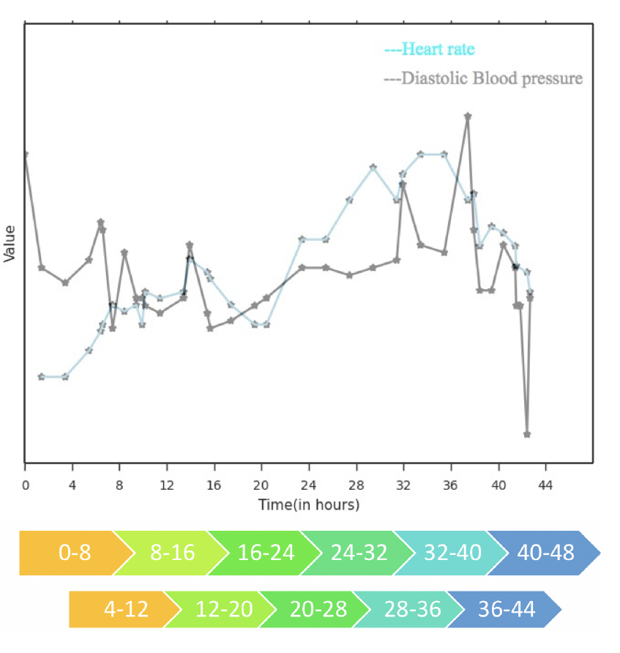
Visualization of Data for a single patient
Providing more data to model
Capturing more dynamics
overlooked

Slide 8
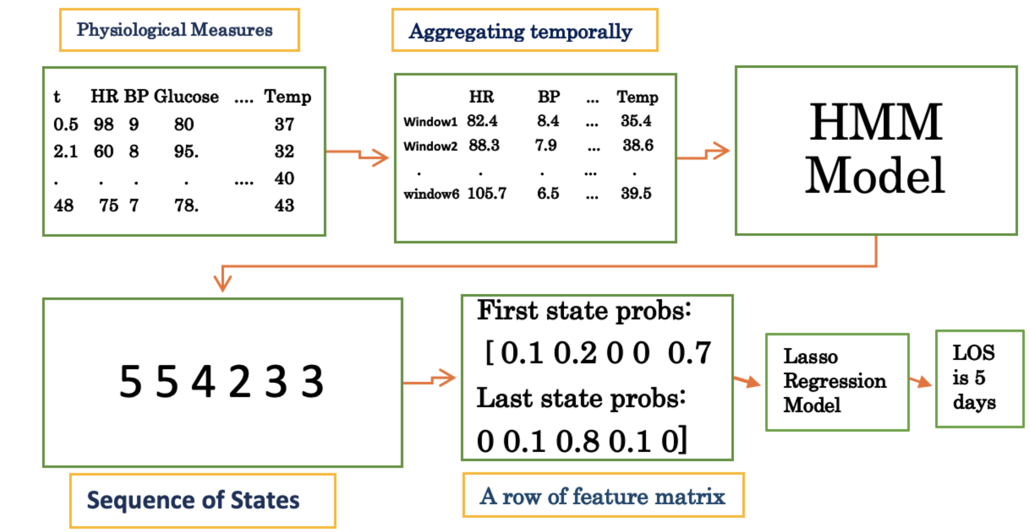
HMM Model Big Picture
Physionet 2012 data after imputation
Average, median or last time point value
Observations for a multi-feature Gaussian model
Parameters:
# of states = 5
Time resolution = 8
# of sequence = 6
Most likely sequence of states
First and last worked the best among all combinations + small number of features
Notes:
Len(Sequence) = # time windows
Spits out likelihood of each state for a given time window

Slide 9
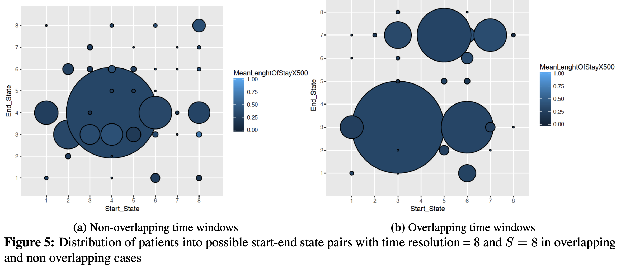
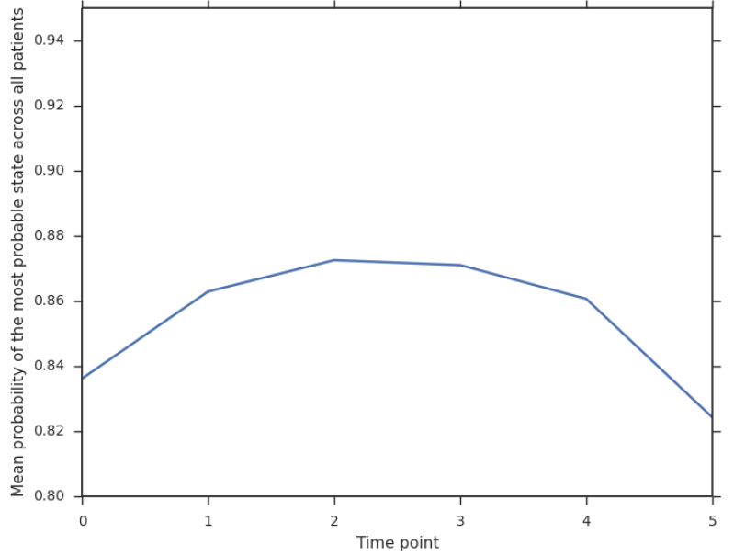
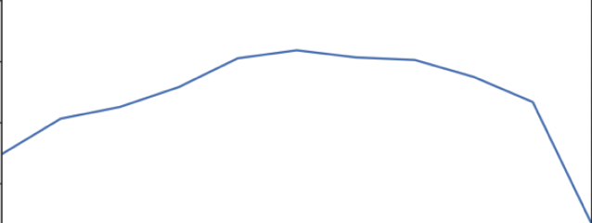
Design choices-Non/Overlapping time windows
Overlapping time windows
Non overlapping time windows
Time frame index
Non overlapping time windows
Overlapping time windows
Distribution and length of stay of patients across different start end pairs
Certainty across timewindows
Notes:
Well distributed

Slide 10
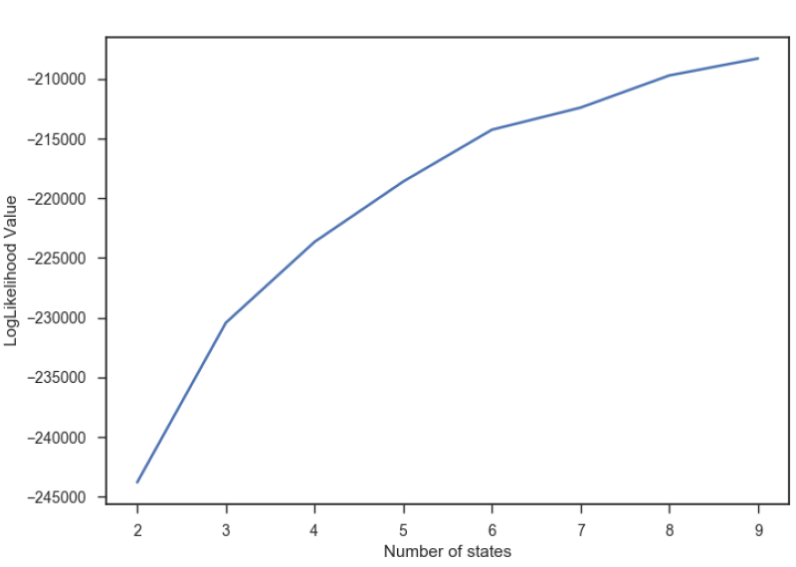
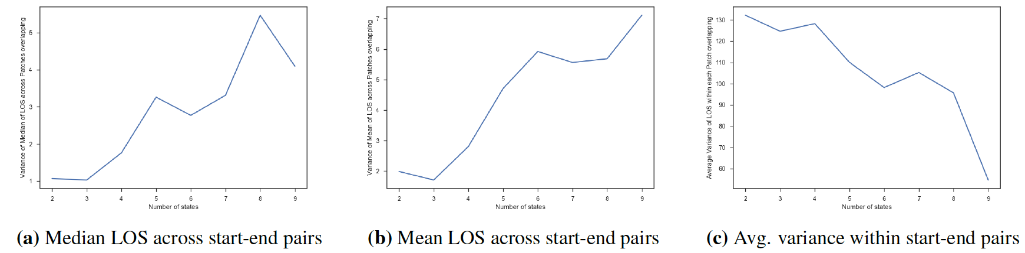
Design choices - Optimum # of states
Number of states = 8
Variance of Median LOS of Patients belonging to one start-end pair across all such pairs
Number of states = 8
Number of states = 8
Number of states
Number of states
Likelihood Value
Average of variance of LOS of Patients belonging to one start-end pair , averaged across all pairs
Number of states

Slide 11
RMSE Comparison
Model | RMSE ( In hours)
Lasso Regression | 234.19
Ridge Regression | 236.91
Poisson Regression | 235.26
Negative Binomial Regression | 235.01
Linear SVR | 237.99
RBF SVR | 236.97
HMM Method | 228.12
SAPS-II | 225.05

Slide 12
Combining ICU type
ICU Type | RMSE P-value w.r.t Baseline | RMSE mean of difference
1 Coronary Care | 0 | -1.97
2 Cardiac Surgery | 0 | -9.39
3 Medical | 0 | -7.56
4 Surgical | 0 | -6.07
ALL | 1 | 6.58
Combined (1,2) (3,4) | (0)(0) | (-9.48)(-9.96)
Combined (1,2,3) (4) | (0)(0.001) | (-12.44) (-4.66)
Combined (1,2,4) (3) | 0.1801 (0) | (-1.7) (-7.45)

Slide 13
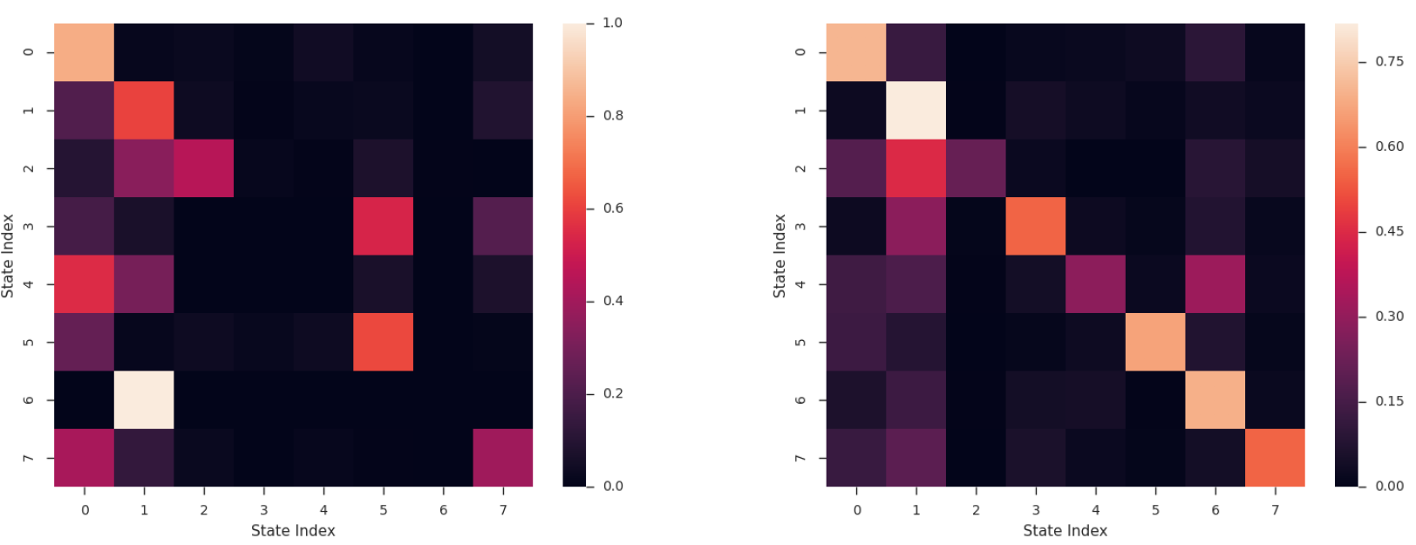
Interpretability
95%
Most probable starting state
Trap state
96%
99%
93%
96%
S/ E | 0 | Not 0
7 | 6.43 | 4.85
Transition matrix ICU types 1 & 2
Transition matrix ICU types 3 & 4

Slide 14
Limitations, Conclusion and Future Work
Generalizability : Lower number of samples
Replicating the same procedure on MIMIC II dataset
More flexibility in #states for different populations
Auxiliary information (e.g., demographics, socioeconomic status)
Enforcing Variability, constraints of learning
Notes:
7 feats vs 2000 not have assessd losing some predictability in the expense of explainability

Slide 15
Thank you!
Email me at: msotood@emory.edu

Slide 16
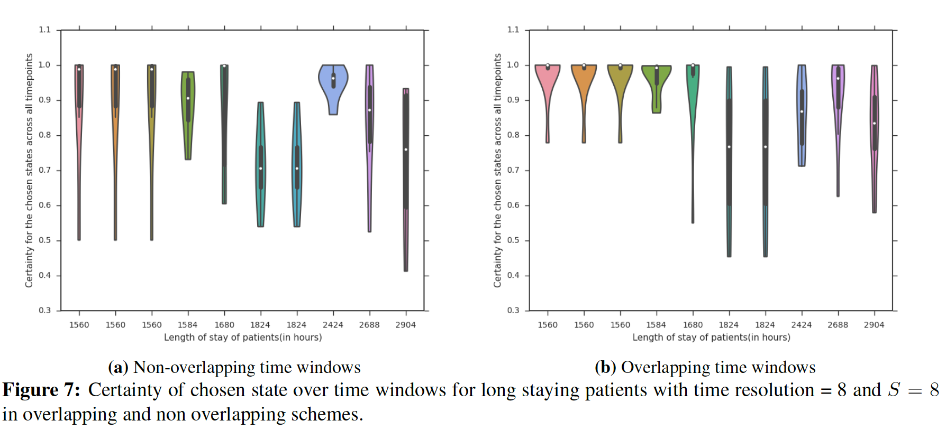
Design choices-Non/Overlapping time windows-continued

Slide 17
Design choices-Non/Overlapping time windows- continued
Non overlapping time windows
Certainty of inferred state at each time window, averaged for all patients
Overlapping time windows
Time frame index

